Slide 1

MOBILE APPLICATION DEVELOPMENT
Introduction to JavaScript

Slide 2

JavaScript
Client Side Language (Vanilla JS, jQuery, React, etc)
Server Side Language (Node.js, MongoDB etc)
Easy to Learn
ES6 (ECMAScript 6) introduced and standardized in 2015
Notes:
Library vs framework difference
Nodes js – open source, cross platform, back end runtime environment
JS introduced in 1995

Slide 3


JS Syntax
Very similar to other programming languages
JavaScript uses the var keyword to declare variables.
Universal principle for identifiers
Strings are text, written within double or single quotes
Output on console using console.log

Slide 4
JS Variables
Can create uninitialized variables or variable declaration (undefined)
Change type of same variable anytime
Recreate same variable again
var a; //undefined
var b = a + 10; // NaN
var x = 10
var x = 100
console.log(x) // 100
var x = "I am one hundred"
console.log(x) // I am one hundred

Slide 5
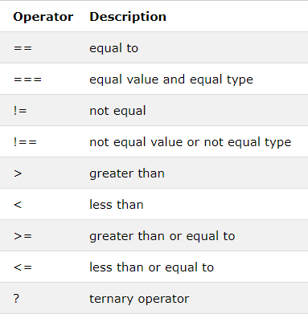

JS Operators
Similar to other programming languages except === and !==
var a = 10
var b = '10'
console.log("a == b:", a == b)
console.log("a === b:", a === b)

Slide 6
JS DataTypes
Number, String, Object etc
Decimal
var x = 15.56
Exponential
var x = 10e5
Object
var person = { firstName:"John", lastName:"Doe", age:50 };

Slide 7
JS typeof Operator
You can use the JavaScript typeof operator to find the type of a JavaScript variable.
The typeof operator returns the type of a variable or an expression:
typeof "" // Returns "string" typeof "John" // Returns "string" typeof "John Doe" // Returns "string"
typeof 0 // Returns "number" typeof 314 // Returns "number" typeof 3.14 // Returns "number" typeof (3) // Returns "number" typeof (3 + 4) // Returns "number"

Slide 8
JS undefined vs null
In JavaScript null is "nothing". It is supposed to be something that doesn't exist.
Unfortunately, in JavaScript, the data type of null is an object.
You can empty an object by setting it to null
undefined and null are equal in value but different in type:
typeof undefined // undefined typeof null // object null === undefined // false null == undefined // true

Slide 9
Primitive Data
A primitive data value is a single simple data value with no additional properties and methods.
The typeof operator can return one of these primitive types:
string
number
boolean
Undefined
typeof "John" // Returns "string" typeof 3.14 // Returns "number" typeof true // Returns "boolean" typeof false // Returns "boolean" typeof x // Returns "undefined" (if x has no value)

Slide 10
Complex Data
The typeof operator can return one of two complex types:
function
object
The typeof operator returns "object" for objects, arrays, and null.
The typeof operator does not return "object" for functions.
typeof {name:'John', age:34} // Returns "object" typeof [1,2,3,4] // Returns "object" (arrays are objects) typeof null // Returns "object" typeof function myFunc(){} // Returns "function"

Slide 11
ES6 Variables
 | var | let | const
Scope | Function | Block | Block
Can change value after creation? | Yes | Yes | No

